Slide 1
CMPUT 207
Discrete Structures
Lecture 09
© Vadim Bulitko : CMPUT 272, Winter 2004, UofA

Slide 2

Quotient-remainder Theorem
For any integer n
For any integer d>0
There exist unique integers q and r
Such that
  n=dq+r
  0≤r<d
q is the quotient : q=n div d
r is the remainder : r=n mod d
Lecture 09
© Vadim Bulitko : CMPUT 272, Winter 2004, UofA

Slide 3
Highest Common Factor
Consider integers a>0, b>0
Consider set F(a,b)={x∈Z s.t. x|a & x|b}
∀x∈F(a,b) [ x≤a & x≤b ]
So F(a,b) is upper bounded thus has a maximum element (by the well-ordering principle)
Call max F(a,b) highest common factor:
  hcf(a,b)
Lecture 09
© Vadim Bulitko : CMPUT 272, Winter 2004, UofA

Slide 4
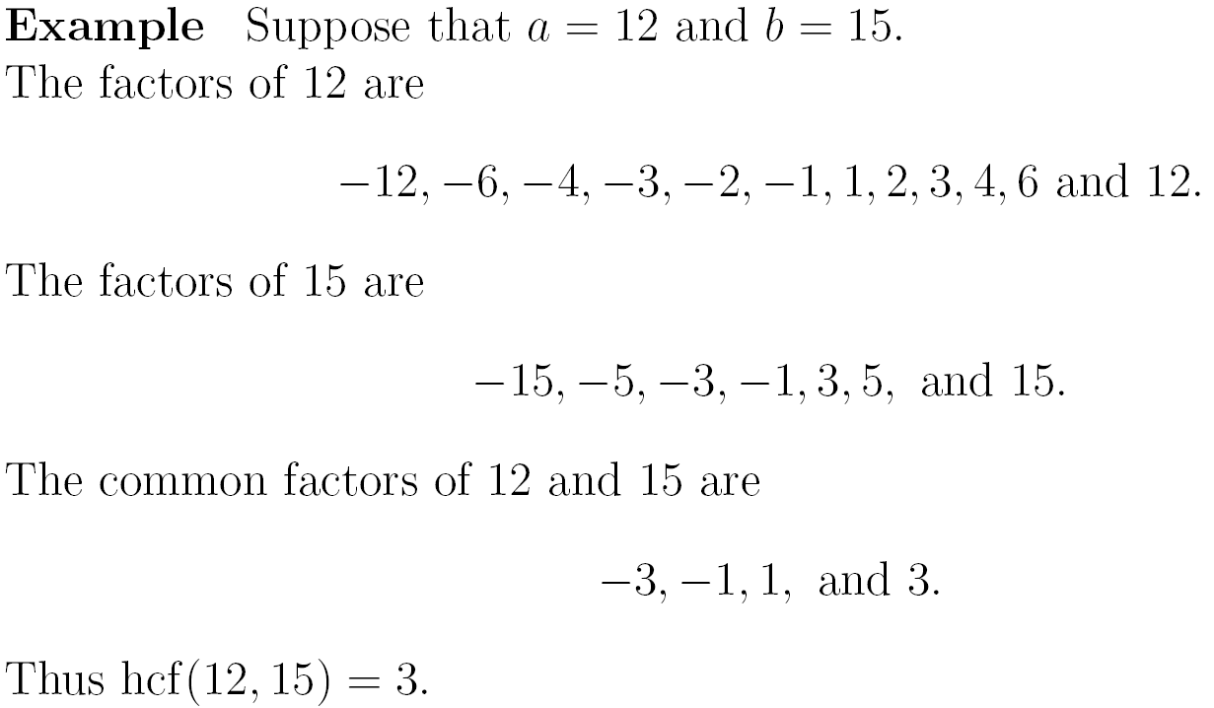
Example
Lecture 09
© Vadim Bulitko : CMPUT 272, Winter 2004, UofA

Slide 5


Euclid’s Algorithm Idea
Works fine for small numbers
What about hcf(4453,1314) ?
Here is an idea:
Lemma. a>b, a=qb+r then hcf(a,b)=hcf(b,r)
Proof.
  Consider F(a,b)={x st x|a & x|b}
  Consider F(b,r)={x st x|r & x|b}
  If x₁∈F(b,r) then x₁|a, thus x₁∈F(a,b)
  If x₂∈F(a,b) then x₂|r, thus x₂∈F(b,r)
Lecture 09
© Vadim Bulitko : CMPUT 272, Winter 2004, UofA

Slide 6
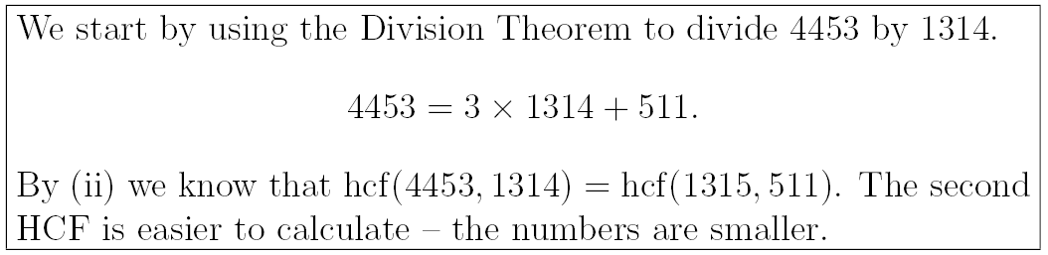
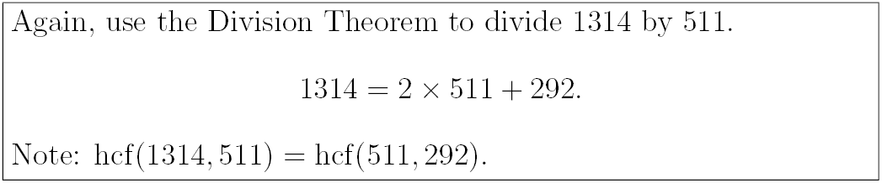
Euclid’s Algorithm
Lecture 09
© Vadim Bulitko : CMPUT 272, Winter 2004, UofA

Slide 7
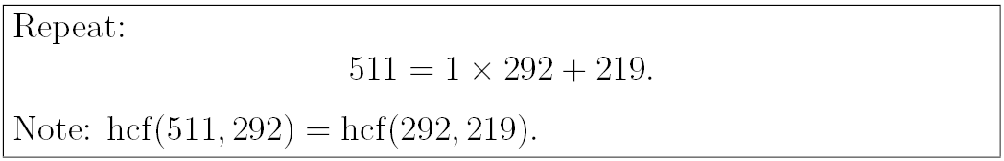
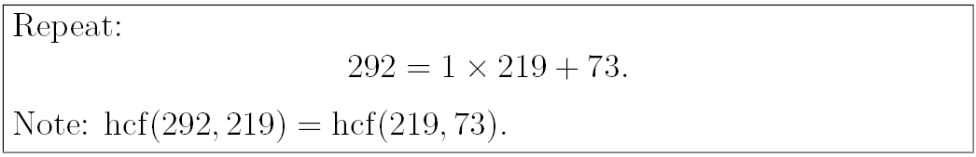
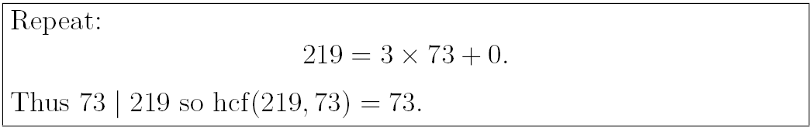

Euclid’s Algorithm
Lecture 09
© Vadim Bulitko : CMPUT 272, Winter 2004, UofA

Slide 8
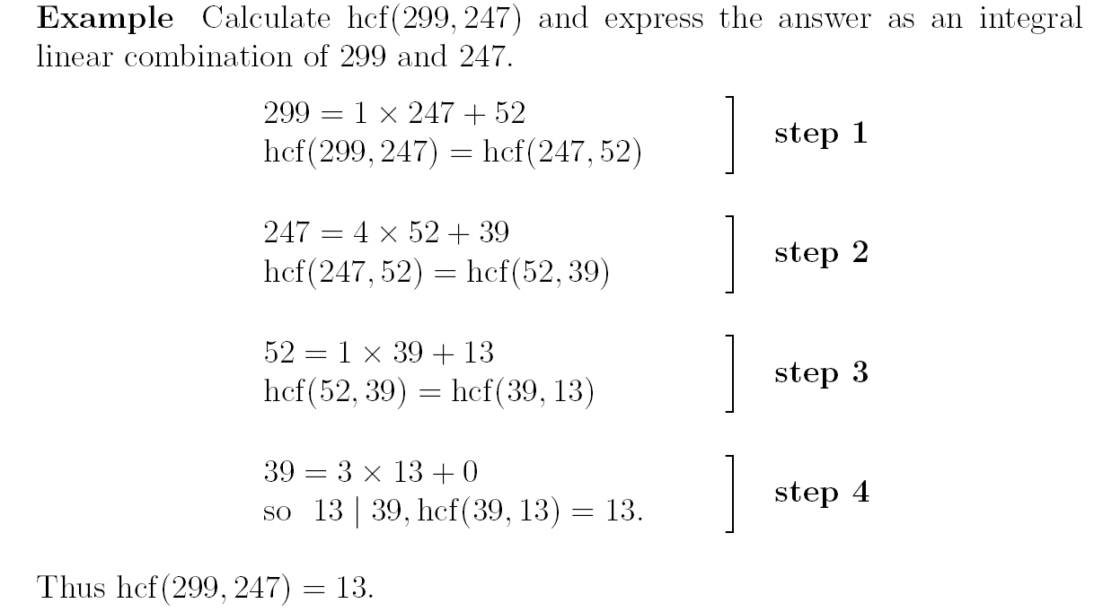
Another Example
Lecture 09
© Vadim Bulitko : CMPUT 272, Winter 2004, UofA

Slide 9
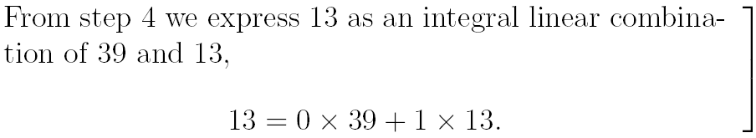
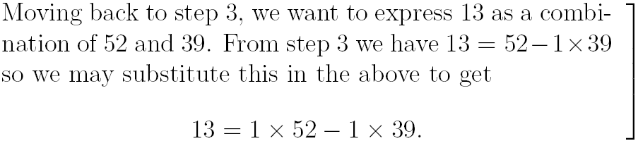
Going Back
Lecture 09
© Vadim Bulitko : CMPUT 272, Winter 2004, UofA

Slide 10
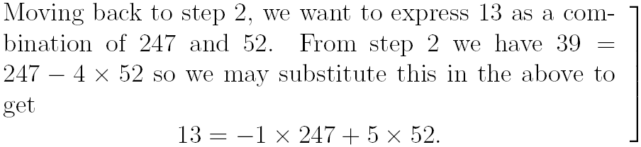
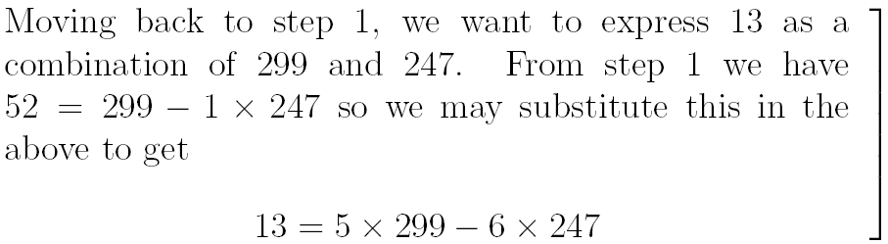
Going Back
Lecture 09
© Vadim Bulitko : CMPUT 272, Winter 2004, UofA

Slide 11
Corollary
For any integer p,q (one of them is not 0)
If
  h=hcf(p,q)
then
  there exist integers x,y s.t. xp+qy=h
Challenge:
  Prove this at home
  Must be your own proof
Lecture 09
© Vadim Bulitko : CMPUT 272, Winter 2004, UofA

Slide 12
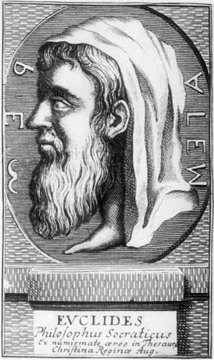
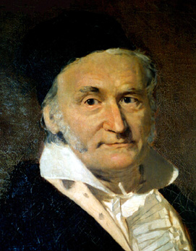
Fundamental Theorem Of Arithmetic
Any integer z≠0 can be represented as:
  z = (-1)^{k} p₁^{k1} p₂^{k2} … p_{n}^{kn}
where:
  p₁<…<p_{n} are prime numbers
  k is 0 or 1
  k₁,…,k_{n} are natural >0
This factorization is unique
Examples:
  24=(-1)⁰ 2³ 3¹
  -7=(-1)¹ 7¹
Lecture 09
© Vadim Bulitko : CMPUT 272, Winter 2004, UofA

Slide 13
Proof (existence)
Let’s prove that for any n∈Z, n>0 such a representation exists
Steps:
  Lemma 0. There are n integers between 1 and n
  Lemma 1. Non-trivial factors of a natural n are strictly less than n
  Lemma 2. Every integer n>1 is divisible by a prime number
  Corollary: can get exclusively prime factors for n>1
Lecture 09
© Vadim Bulitko : CMPUT 272, Winter 2004, UofA

Slide 14

Proof (uniqueness)
Let’s prove that such representation is unique
Steps:
  Lemma 3. If h=hcf(p,q) then there exist integers x,y s.t. xp+qy=h
  Lemma 4 (E1stT). If p|ab and prime(p) then p|a or p|b
  Main Proof:
    Suppose not. Then two different factorizations exist
    Then arrive at a contradiction
Lecture 09
© Vadim Bulitko : CMPUT 272, Winter 2004, UofA

Slide 15
Further Information
Lecture notes (we reproduced some parts from):
  http://www.mat.bham.ac.uk/P.J.Flavell/teaching/Foundation/LectureNotes/
Some background:
  http://mathworld.wolfram.com/EuclidsTheorems.html
How to discover the proof:
  http://www.dpmms.cam.ac.uk/~wtg10/FTA.html
Lecture 09
© Vadim Bulitko : CMPUT 272, Winter 2004, UofA

